Slide 1
Chapter 17: TLS
Freshman Seminar
2022.03.04
Sumin Sohn

Slide 2
Contents
17.5 TLS 1.3

Slide 3
17.5 TLS 1.3

Slide 4
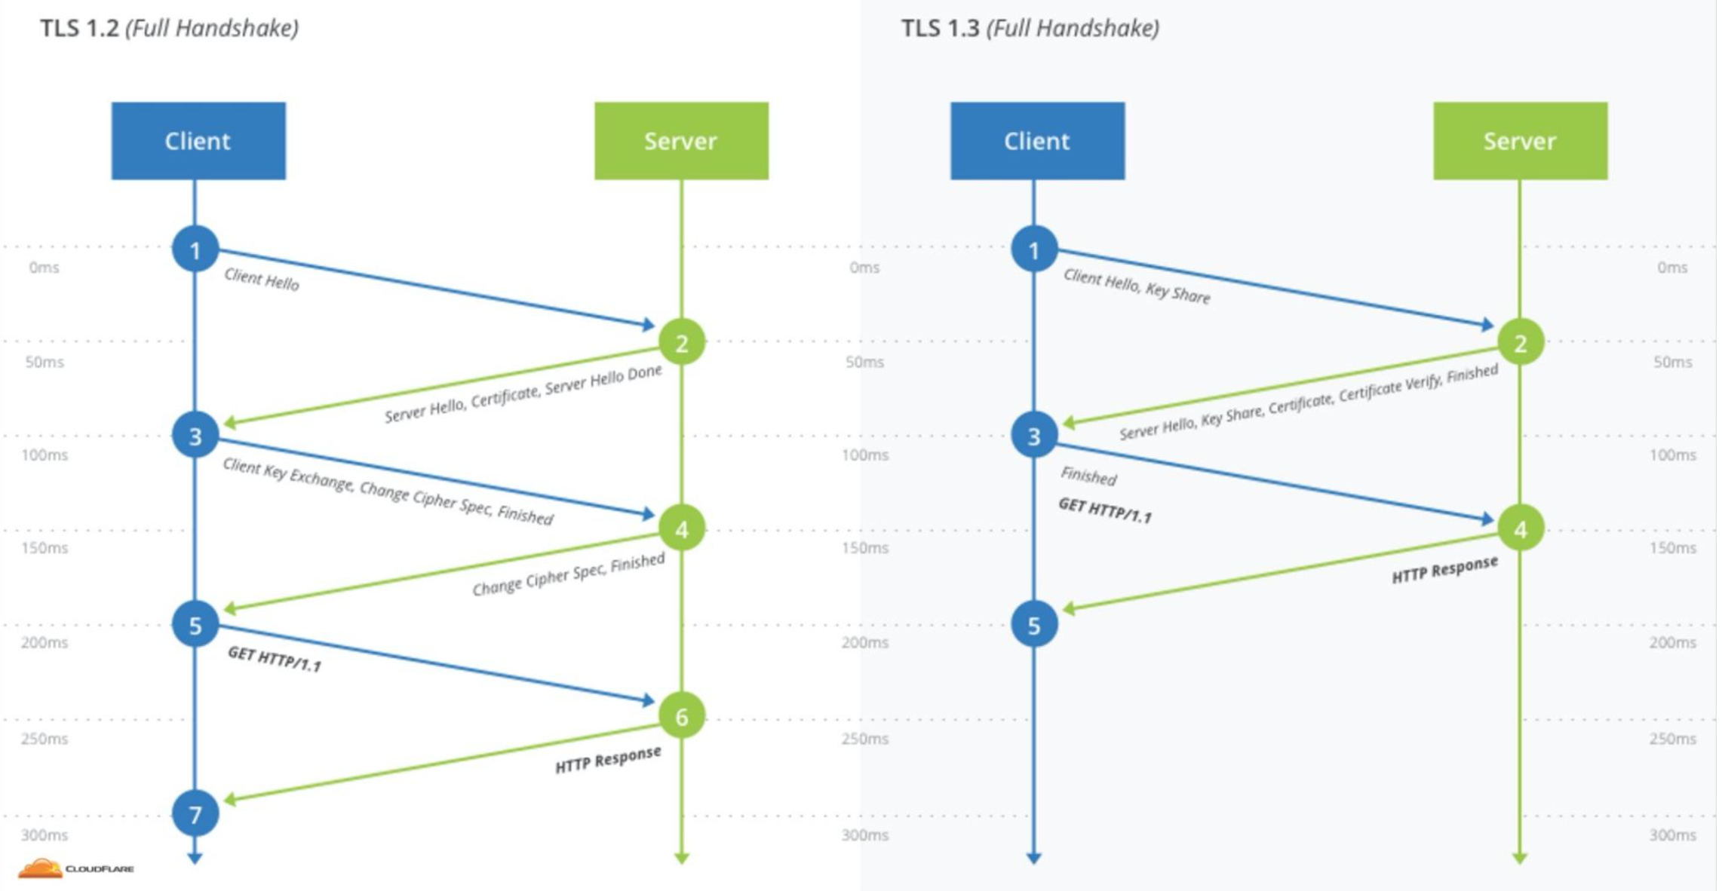
1-RTT
Round trip time is reduced by one compared to 1.2
How?
1.3 reduced shared symmetric key options
Don’t need to wait until the server confirm shared symmetric key option
Reducing 1-RTT is critical to speed

Slide 5
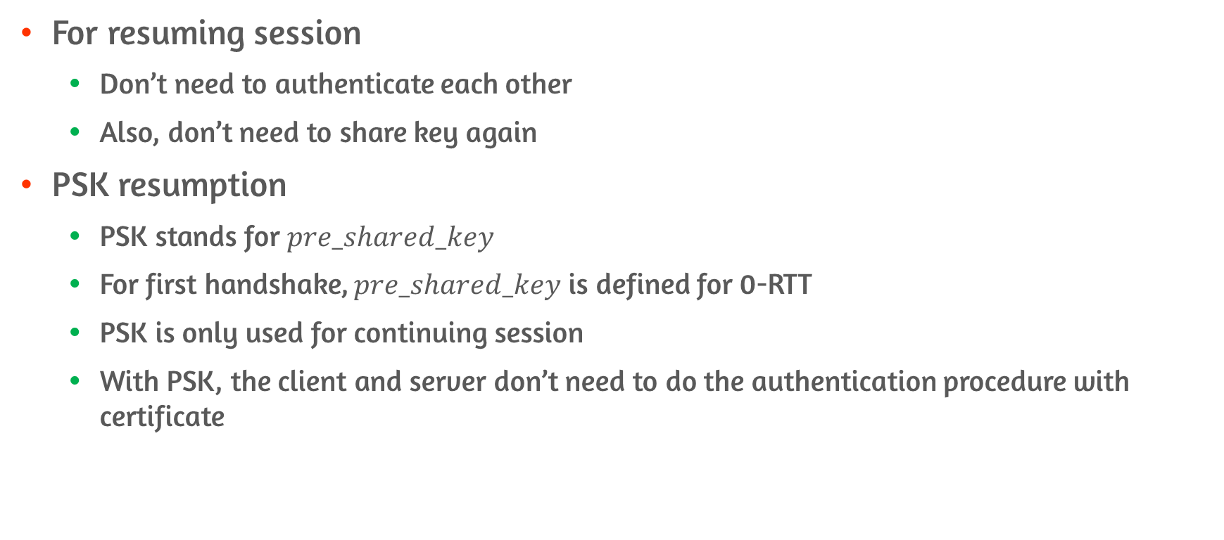
0-RTT Resumption
For resuming session
Don’t need to authenticate each other
Also, don’t need to share key again
PSK resumption
PSK stands for $pre_shared_key$
For first handshake, $pre_shared_key$ is defined for 0-RTT
PSK is only used for continuing session
With PSK, the client and server don’t need to do the authentication procedure with certificate

Slide 6
0-RTT Replay Attack
The attacker can do the replay attack if attacker can obtain 0-RTT packet
The server must be prudent for turning on 0-RTT option

Slide 7
Perfect Forward Secrecy
Encryption system that changes keys frequently and automatically
Achieved by ephemeral session key share
Diffie hellman key share is representative
E.g., key ‘A’ is exposed
RSA
Massive amount of sensitive data can be exposed
DH
Only certain part of sensitive data is exposed

Slide 8
Forwards vs Backwards Secrecy
Forward secrecy
Guards against future compromises of past sessions
Backward secrecy
Self-mitigate compromises of past sessions
Main difference
Forward is preventative
Backward is mitigating

Slide 9
Double Ratchet Algorithm

Slide 10
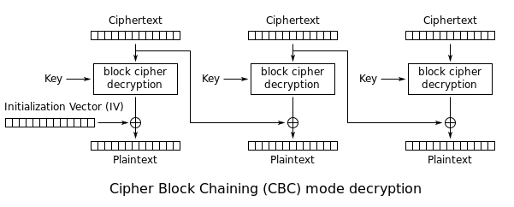
POODLE attack #1
Padding Oracle attack can be possible by downgrading TLS version
By downgrading to SSL v3.0
Solved by Disabling SSL v3.0
Attacker with the ability to modify ciphertext can extract value of the plaintext
Use of Mac-then-encrypt and CBC make this attack possible
Because of MtE, the receiver need to decrypt

Slide 11
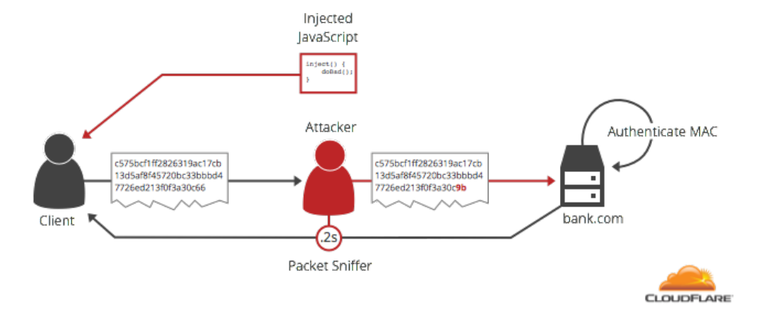
POODLE attack #2
Three possible ways for the decrypted data look
Invalid padding
Valid padding, wrong HMAC
Valid padding, correct HMAC
From the second case, the attacker can assume the plaintext

Slide 12
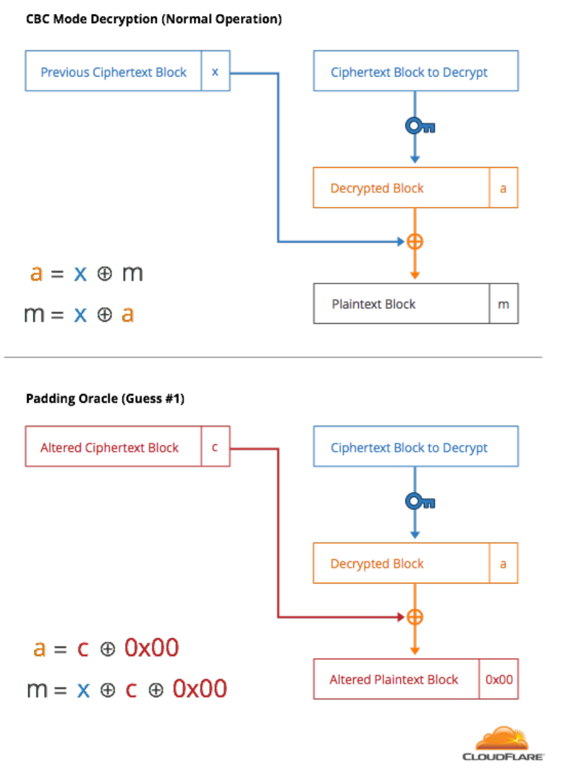
Poodle Attack #3
By changing bits of previous ciphertext block, second condition occur
Wrong HMAC and correct padding scenario make attacker possible to decrypted block
Can know full plaintext by adjusting padding bits

Slide 13
Authenticated Encryption with Associated Data
The combination of cipher and MAC
GCM was the representation of AEAD
Data is both authenticated and encrypted
AES-GCM/CCM Was explained on previous chapter

Slide 14
Conclusion
Change virtual circuit to datagram to make router’s job easier
Learn how router really works by examining inside of router
IPv4 and IPv6
Routing algorithm is needed to determine the best path
Learn how broadcasting and multicasting works

